Slide 1
Connecting Time and Timbre: Computational Methods for Generative Rhythmic Loops in Symbolic and Signal Domains
Cárthach Ó Nuanáin
Thesis Directors: Barcelona, March 2018 Thesis Committee:
Dr. Sergi Jordà Dr. Diemo Schwarz
Mr. Perfecto Herrera Dr. Jordi Janer
Dr. Frederic Font

Slide 2
Dance Music Research
A mostly digital
strand of music
Ripe for Computational
Musical Analysis
Recent phenomenon (1980s)
Literature and discourse
lacking compared to other
styles

Slide 3
Dance Music Examples
(Video on filesystem)

Slide 4
Electronic Dance Music
Emerging in the 1980s North America
Intended for dancing at nightclubs or illicit raves
Highly repetitive and loop-based
Rhythm-focussed
“the rhythm is the melody” (Reynolds, 2013)
Less about traditional songwriting and compositional techniques in terms of harmony and form
More about sound design and layering of timbre
Using a combination of synthesised and sampled sounds

Slide 5
Thesis Goals
Musicological study of pervasive styles in dance music – techno, house, breakbeat etc.
Focussing on the rhythmic pattern and timbres in loops
What is the state of the art in generative dance music?
Propose new symbolic and audio methods
From a user perspective:
Metaphors for interaction and visualisation.
Evaluation methodologies.
Testing with real users.

Slide 6







“Musical expert agents, supportive and inspirational systems for melody, harmony, rhythm, structure or style, providing suggestions from sample to song level, while guiding users when they lack inspiration or technical or musical knowledge.”
Partners:

Slide 7
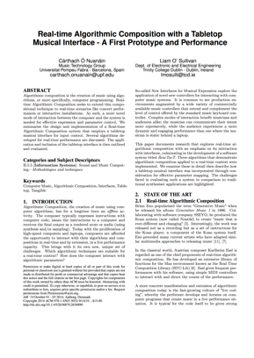
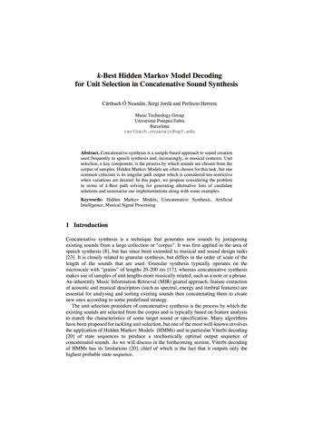
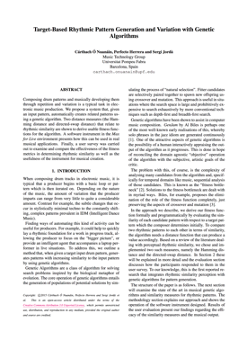
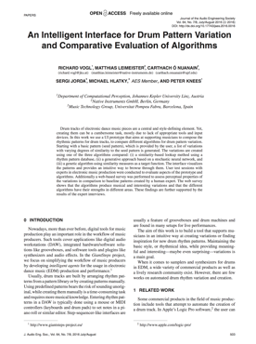
Overview
Motivations/Context
Symbolic Rhythm
Generation
Exploring
Concatenative Synthesis
1
2
3
Electronic Dance Music
GiantSteps Project
Goals
State of the Art
A genetic algorithm with rhythm similarity knowledge
Evaluation and Criticisms
State of the Art
Algorithmic Techniques
Improvements for timbre analysis and HMM unit selection

Slide 8
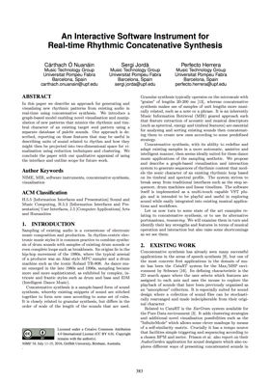
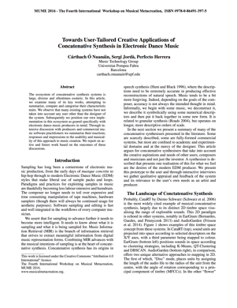
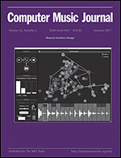
Overview (cont.)
User-tailored Rhythmic
Concatenative Synthesis
Evaluation
Conclusions
4
5
6
Interfaces for computer music
Visualisation
RhythmCAT – an instrument for rhythmic concatenative synthesis
Objective system evaluation
Subject listener survey
Qualitative evaluation and thematic user analysis
Contributions
Future Work

Slide 9
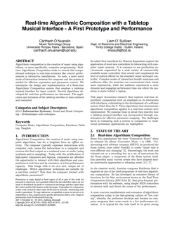

Section 2
Motivations/Context
Symbolic Rhythm
Generation
Exploring
Concatenative Synthesis
1
2
3
Electronic Dance Music
GiantSteps Project
Goals
State of the Art
A genetic algorithm with rhythm similarity knowledge
Evaluation and Criticisms
State of the Art
Algorithmic Techniques
Improvements for timbre analysis and HMM unit selection

Slide 10
Symbolic Versus Audio
Rhythm can be encoded in both, dance production uses both
Manipulation of MIDI compatible tools (drum machines)
Manipulation of existing audio sources
Start with symbolic
More flexible and easier to handle than audio
Historically many algorithmic composition methods

Slide 11
Symbolic Rhythm Generation - State of the Art
Genetic Algorithms
evoDrummer (Kaliakatsos-Papakostas, 2013) – fitness evaluates density, syncopation, intensity (loudness)
Database Interpolation
KIN.RECOMBINATOR (Sioros,G. & Guedes, C, 2011)
Native Instruments (in a co-authored paper – Vogl et al., 2016)
Markov Chains
Dr. Drums (Gómez-Marin, 2017)
Hybrids:
Kinetic Engine (Eigenfeldt): Markov+GA+Fuzzy Logic

Slide 12
Contribution: Genetic Algorithm for Rhythm
Previous Work:
Grammatical Evolution = Genetic Algorithms + Formal Grammars
Generate small melody fragments (Ó Nuanáin & O’Sullivan, 2015)
Genetic Algorithm
Evolve candidate solutions
Selection
Crossover
Mutation
Fitness Function

Slide 13
Binary Rhythms
Dominant representation for symbolic drum patterns
Intuitive for drum machines
Natural for GAs

Slide 14
Rhythm Similarity
How to build a fitness function for rhythm, using binary forms?
We can consider the similarity of generated rhythms to target
Using a GA based on similarity to a target we can achieve:
Repetition: repeat and transfer characteristics of the target pattern
Variation: introduce new characteristics in the patterns

Slide 15
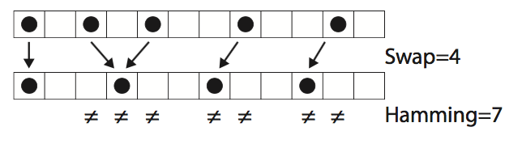
Measures of Rhythmic Similarity
Toussaint summarises many (2003, 2004, 2013)
We focus on two…
Same Hamming distance!

Slide 16
Directed-Swap
Variation of swap distance that can handle pattern with different numbers of onsets
Proposed by Díaz-Báñez for analysis of flamenco (2004)
Captures more “horizontality”
Not as trivial to compute!
Colannino and Toussaint (2005) - Dijkstra formulation (O(n²))

Slide 17
SimpleGA
Pd and Max C++ external for generating strings with a GA
Fitness function based on hamming or directed-swap to a target
https://github.com/carthach/simplega

Slide 18
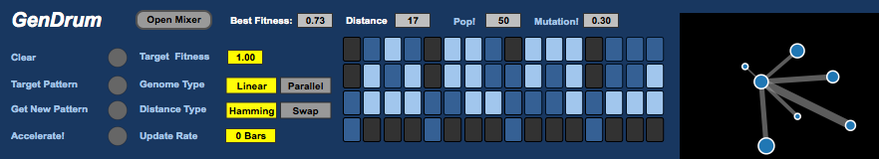
GenDrum
Max for Live Instrument for drum pattern generation (Ó Nuanáin et al., 2015)
Kick, snare, hat and other.
Symbolic MIDI – remappable by the user
Choose String Type
Choose Distance Measure
Input Target Pattern
https://github.com/carthach/gendrum

Slide 19
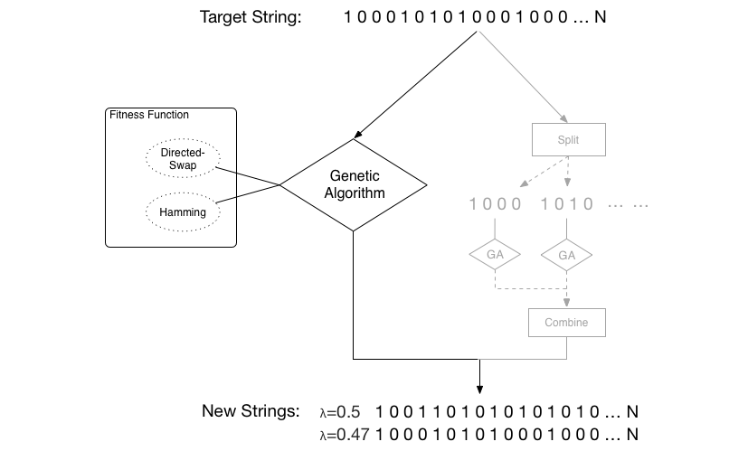
String Type - Linear

Slide 20
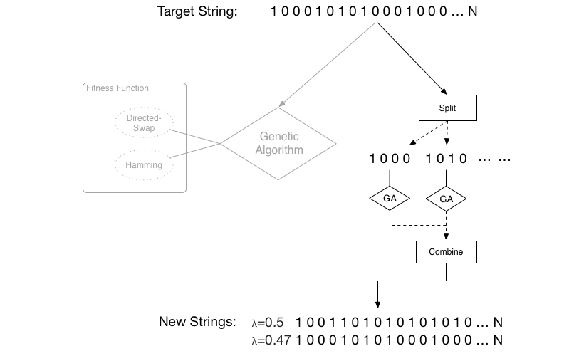
String Type - Parallel

Slide 21
Listener Survey
21 subjects asked to rate the similarity of patterns to a target and evaluate their “interestingness”.
Compare the distance measure and the string type
Three different targets, 72 variations

Slide 22
Results – Likert Responses and Fitness

Slide 23
Results – Correlation Analysis
Hamming is “better” (Spearman’s Rank 0.784, p<0.05).
t-Test and Kruskal-Wallis ANOVA did not show significance difference between string types.

Slide 24
GenDrum v2.0
New Features, fitness is a linear combination of:
Similarity
Density – used in (Jordà et al., 2016)
Syncopation - using WNBD measure (Gómez et al., 2005)
Not tested, but demoed at ISMIR (Faraldo et al., 2015)

Slide 25
Symbolic Rhythm Generation - Conclusions
Criticisms
Verticality and interdependence between layers
Stress and accents (use floating point?)
Groove and swing
Perception heavily dependent on timbre
Moving to Audio:-
Capture patterns and timbre
Culture, style, performer, engineer/producer.

Slide 26


Section 3
Motivations/Context
Symbolic Rhythm
Generation
Exploring
Concatenative Synthesis
1
2
3
Electronic Dance Music
GiantSteps Project
Goals
State of the Art
A genetic algorithm with rhythm similarity knowledge
Evaluation and Criticisms
State of the Art
Algorithmic Techniques
Improvements for timbre analysis and HMM unit selection

Slide 27
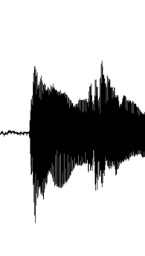
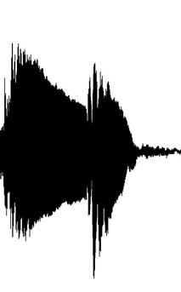
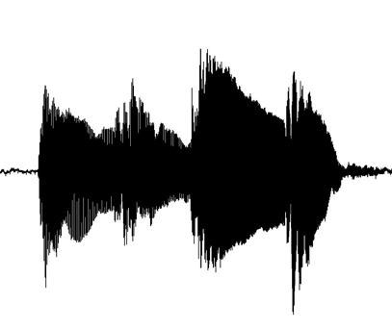
Concatenative Synthesis
Creating new sounds by stitching existing ones together according to some rules and procedures.
Related to Granular Synthesis (Roads 2004).
Larger orders of scale
Descriptor Based
Targeted
+
=

Slide 28
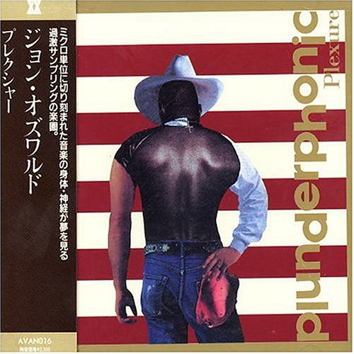
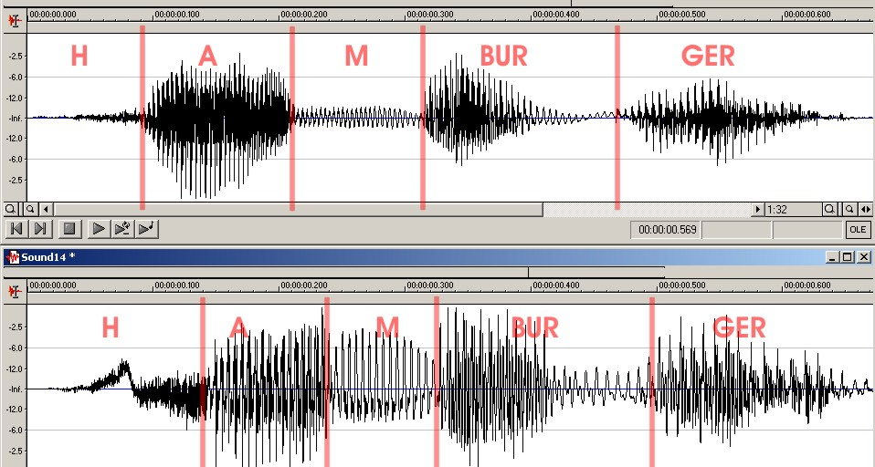
Antecedents
Plunderphonics (Oswald, 1985)
Mashups of existing audio recordings
Digital Speech Synthesis (Hunt & Black, 1996)
Unit selection via HMM and Viterbi

Slide 29
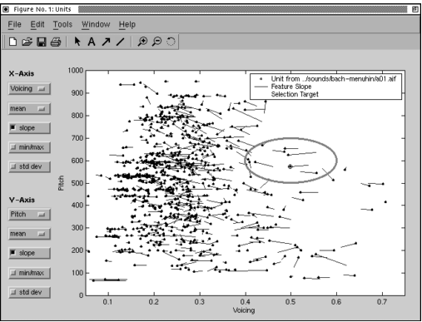
Early Digital Musical Concatenative Synthesis
Caterpillar (Schwarz, 2000)
Unit Selection Viterbi Algorithm (HMMs)
Constraint Satisfaction
Musaicing (Zils & Pachet 2001)
Musical Mosaicing
Constraint Satisfaction
“Mimic” Mode to model a target
User selectable constraints

Slide 30
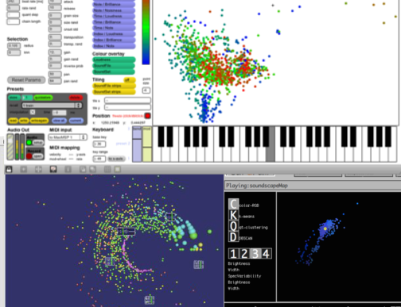
State of The Art – 2D Timbre Spaces
CatArT (Schwarz, 2006)
AudioGarden (Frisson et al., 2010)
EarGram (Bernardes, 2014)

Slide 31
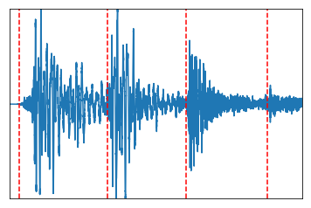
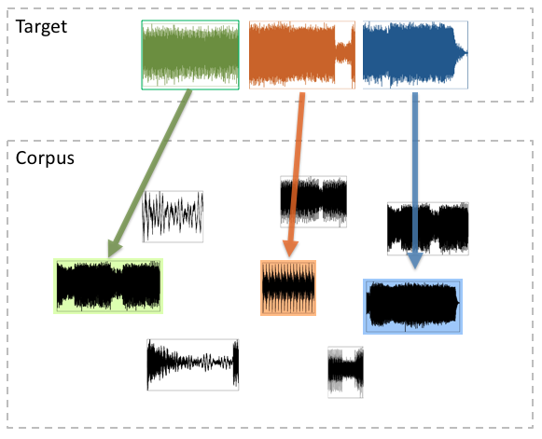
Concatenative Synthesis Stages and Theory
(A)
Unit Decomposition
(B)
Feature Analysis
(C)
Unit Selection
Notes:
Make this a diagram!

Slide 32

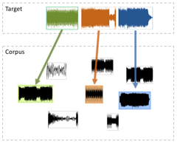
(A) Unit Decomposition
Unit scales:
Frame-based on some fixed sample size – (in time domain or using FFT/IFFT resynthesis)
Onsets using some onset detection methods
Beats with the aid of tempo tracking.
Onset detection seems to be the most dominant (onset ~= note)

Slide 33
Track – ”My Sound” by Joey Beltram (R&S Records)

Slide 34
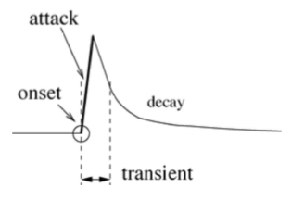
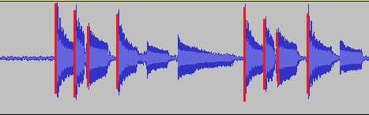
Onset Detection
Many approaches exist for detecting start of notes in signals
(Bello et al. 2005)
Typical stages include:
Reduce signal to onset detection novelty function
Perform peak peaking to find local maxima corresponding to onset times

Slide 35
Onset Detection Methods
Typically involve improving the novelty function.
Evaluated three methods from libraries:
Essentia-OnsetRate:
complex spectral differential + high frequency content (HFC)
Madmom-Superflux:
spectral tracking, vibrato suppression
soft attacks such as strings, wind and voice. (Böck & Widmer, 2013)
Madmom-CNN:
Convolutional Neural Network (CNN)
Detect likelihood of onsets within frame (Schlüter & Böck, 2013, 2014).

Slide 36
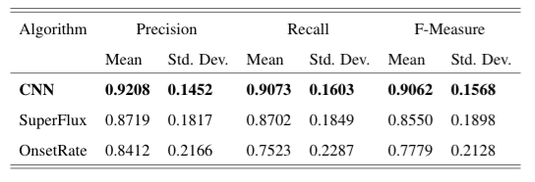
Results

Slide 37
But what about performance?

Slide 38
(B) Feature Analysis
Unit Decomposition -> segmented, atomic units
Need to analyse the units using descriptors or feature extractors
Feature analysis allows us to select units by comparing their analysed features
Feature Types:
Temporal (log-attack time and loudness)
Spectral
Musical (pitch and chroma)
Timbral

Slide 39
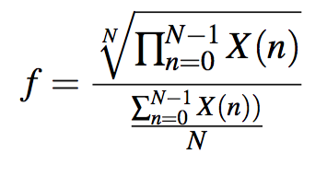
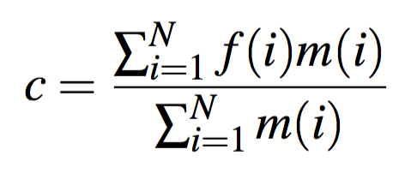
Feature Analysis - Spectral
Spectral Features:
Flatness
Centroid

Slide 40
Feature Analysis - Timbre
Timbre
“that attribute of auditory sensation, in terms of which a listener can judge that two sounds similarly presented and having the same loudness and pitch are dissimilar”
Of course temporal and spectral features influence our perception of timbre.
One of the de facto descriptors used for analysing and comparing timbres are the Mel Frequency Cepstral Coefficients (MFCCs).
But other *FCCs exist, are they better?

Slide 41
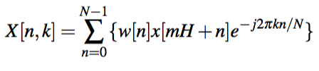
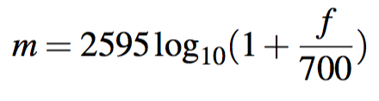
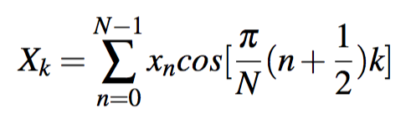
MFCC Extraction in Essentia*
https://github.com/carthach/gendrum

Slide 42
Frequency Warping

Slide 43
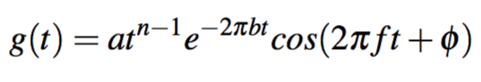
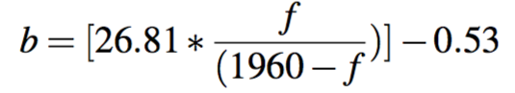
Contribution: Improved Timbre Analysis
Implement and evaluate other extractors
GFCC
Equivalent Rectangular Bands (ERB) from Gammatone Filter
Modelled on cochlea from smaller mammals
Analysing large online collections (Roma, 2015)
BFCC
Bark scale - Critical bands of basilar membrane
Useful for percussion ID (Brent, 2009a; 2009b; 2010)

Slide 44
BFCC Implementation
GFCC is already in Essentia, BFCC isn’t
Very few standards or implementations exist elsewhere!
Port of Dan Ellis’s Rastamat* to C++
*https://labrosa.ee.columbia.edu/matlab/rastamat/

Slide 45
Classification Experiment
Verify that our BFCC works, and other features chosen
See if the BFCC and GFCC improves over MFCC
Two newly compiled corpora
General timbres (orchestral)
Drum timbres
Compared three different classifiers, with different feature configurations
k-NN (k=1)
ANN
SVM

Slide 46
Classification - Orchestral Dataset
100 samples per instrument
Randomised selection
All articulations
http://www.philharmonia.co.uk/explore/sound_samples
https://github.com/carthach/phd_thesis/tree/master/classification/orchestra

Slide 47
Drum Dataset
Compiled from a variety of free web sources
Contains electronic and acoustic sounds
https://github.com/carthach/phd_thesis/tree/master/classification/drums

Slide 48
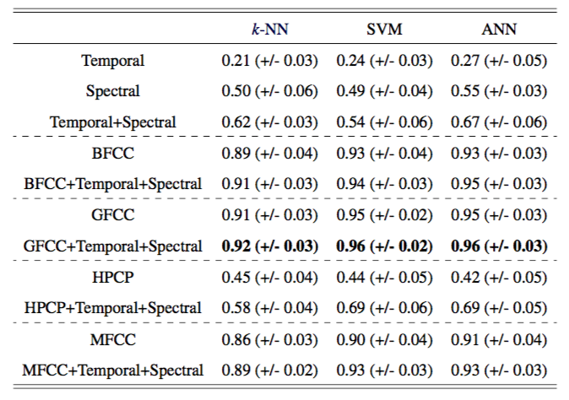
Orchestral Classification Results

Slide 49
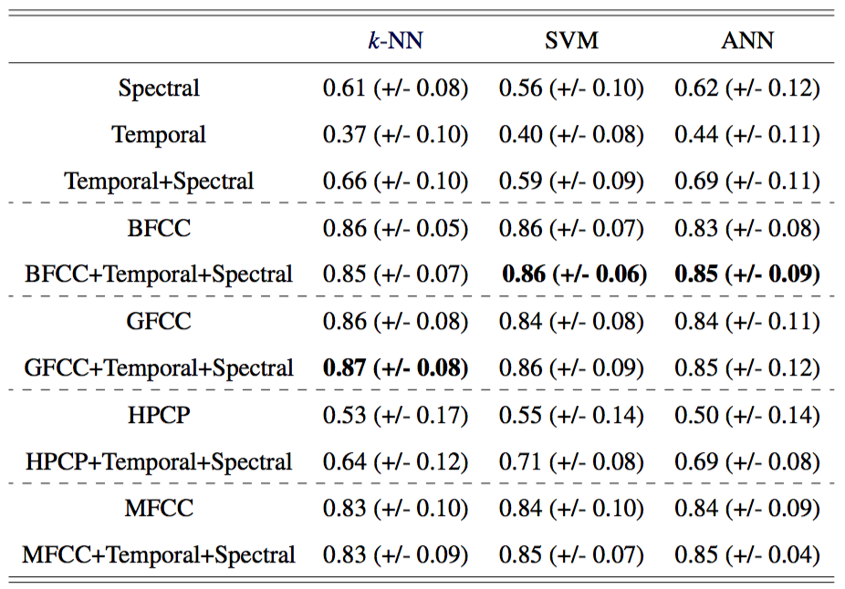
Drum Classification Results

Slide 50
Discussion
Results are higher for the orchestral dataset
More variance between timbres
Electronic drum sounds are created from very limited means
*FCC are a very capable descriptor by themselves
But adding other descriptors does increase accuracy
Our BFCC extractor improves over MFCC
And confirming Brent’s findings, but on larger collections
GFCC outperforms both

Slide 51
(C) Unit Selection
Combine segmented and analysed units together in an intelligent manner – using a target
We describe and implement 4 methods
Linear Search
k-D Tree
Viterbi Decoding
List Viterbi Decoding
Using Parallel Decoder
Using Graph Decoder

Slide 52
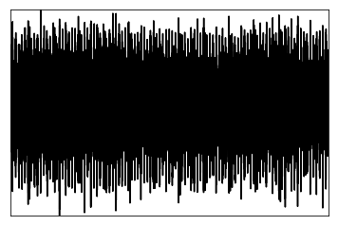
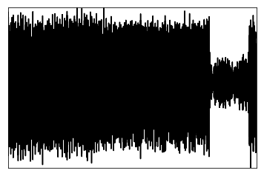
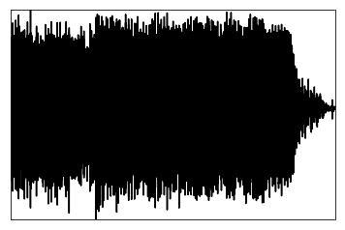
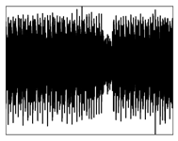
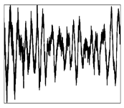
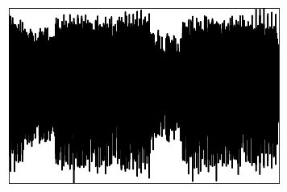
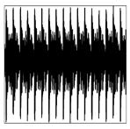
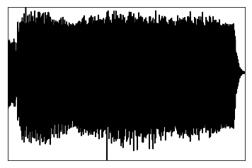
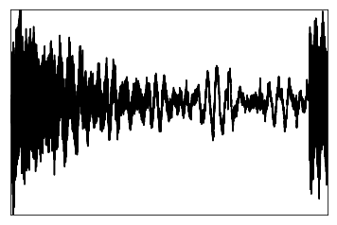
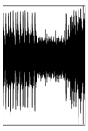
Unit Selection - Linear Search
Target
Corpus

Slide 53
Linear Search
Target
f1 | f2 | … | fN
0.5 | 330.0 | … | 0.2578
Corpus

Slide 54
Linear Search
Target
f1 | f2 | … | fN
0.5 | 330.0 | … | 0.2578
Corpus
Target Cost
f1 | f2 | … | fN
0.21 | 440.0 | … | 3.4

Slide 55
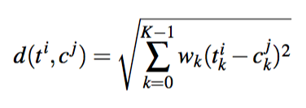
Linear Search
Target Cost computed using a suitable distance or similarity measure
Weighted Euclidean – allows us to emphasise certain features
Used in many systems such as Sturm (2006) and Collins (2007)

Slide 56
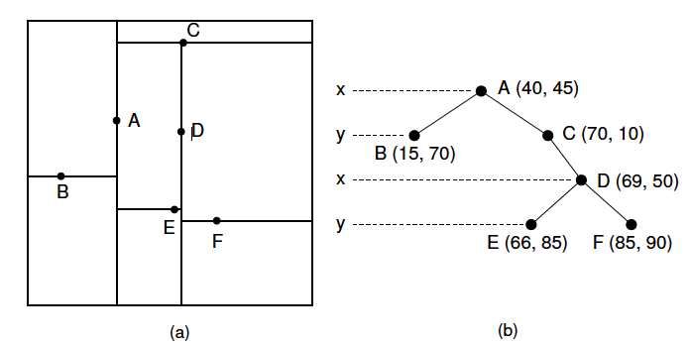
kD-Tree
Linear Search is exhaustive, if you don’t want the variational possibilities a kD-Tree may be faster.

Slide 57
Unit Selection – Hidden Markov Model (HMM)
Target
Corpus
Target Cost
Join or Concatenation Cost

Slide 58
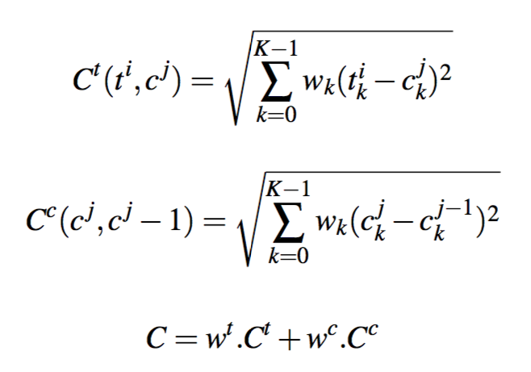
HMMs
Allows minimisation of target and concatenation costs
(Schwarz, 2000)
Concatenation cost to ensure consistency or stability of certain features (e.g. pitch and loudness)

Slide 59
Contribution: List Viterbi Decoding
Viterbi Algorithm:
Return highest probability (or minimal costs) hidden state sequence for set observed symbols (target units)
Single output of `best’ sequence
May not be actual perceptual best
Music: restrictive for exploring variation
We implement two solutions (Ó Nuanáin et al., 2017*)
Parallel Decoder
Graph-Based Decoder
Best Poster Award @ CMMR 2017

Slide 60
The Regular Viterbi Decoder

Slide 61
The Parallel Decoder*
Store the k highest scoring probabilities
(Seshadri & Sundberg, 1994)
*https://github.com/carthach/kbestviterbi

Slide 62
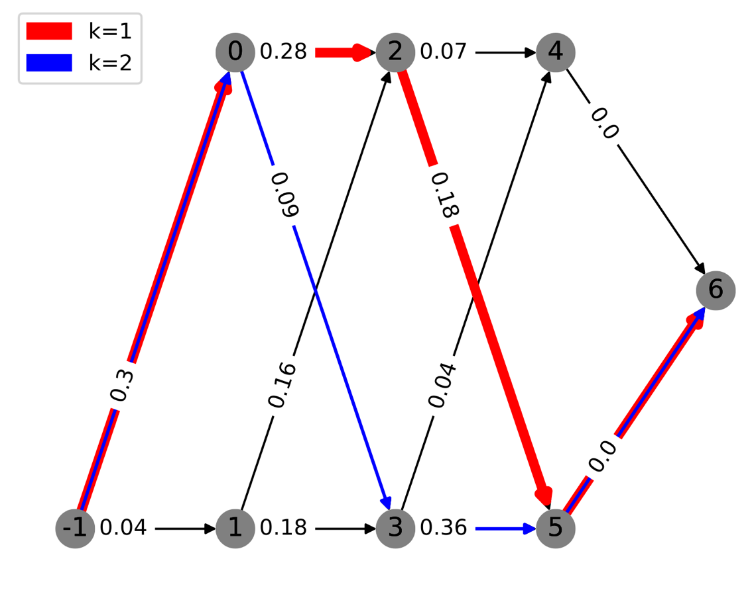
The Graph Decoder*
A HMM specification can be reformulated as a shortest path problem
Yen’s Algorithm (1971)
Eppstein (1997)
Implementations exist!
NetworkX (Python)
*https://github.com/carthach/kbestviterbi

Slide 63
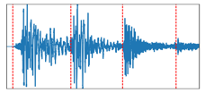

Putting it all together
Notes:
Make this a diagram!

Slide 64
Contribution: The PyConcat Library*
Python environment for conducting research-oriented concatenative synthesis of signals.
Encapsulates everything discussed in the thesis and these slides:
Segmentation
None, framewise FFTs, onsets, beats
Feature Analysis
*FCCs, spectral moments, loudness, f0, HPCPs
Unit Selection
Brute force linear search, kDTree, Viterbi, k-best Viterbi decoding
*https://github.com/carthach/PyConcat

Slide 65
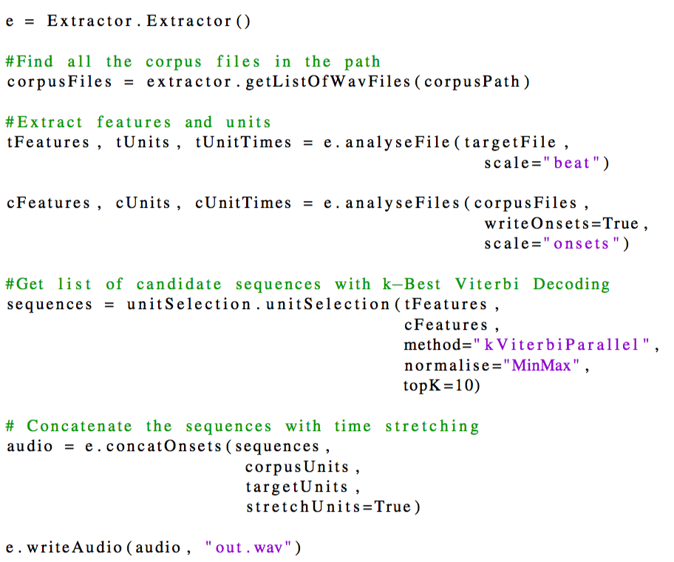

Slide 66
Experiments
List Decoding methods are still very prototypical.
Large-scale evaluation is a challenge
In (Ó Nuanáin, 2017) we do perform some simple analysis:
Equivalency: do they output the same k=1 as regular Viterbi, are other ks similar?
Performance: how are running times
Feature Preservation: how do target and sequences compared concentrating on particular features
Timbre: are overall timbral profiles similar

Slide 67

Experiments - Equivalency
Resynthesise 8 notes of a piano scale with itself
Regular Viterbi
Parallel
Graph

Slide 68

Experiments – Running Time
Our Parallel Decoder is faster than NetworkX’s shortest paths

Slide 69

Experiments – Fundamental Frequency (Parallel)
Resynthesising piano scale target with Philharmonia

Slide 70

Experiments – MFCC Timbre (Parallel)

Slide 71
Section 3 - Conclusion
We described the full pipeline of concatenative synthesis
New contributions in the area of
Timbre Analysis
Unit Selection
Research focussed framework for experimenting with state of the art concatenative synthesis
What about the user?

Slide 72

Section 4
User-tailored Rhythmic
Concatenative Synthesis
Evaluation
Conclusions
4
5
6
Interfaces for computer music
Visualisation
RhythmCAT – an instrument for rhythmic concatenative synthesis
Objective system evaluation
Subject listener survey
Qualitative evaluation and thematic user analysis
Contributions
Future Work

Slide 73
From research to users
Previous contributions advance research and SOTA
Building user-tailored concatenative synthesis systems
Tradeoff: performance <-> accuracy
*RhythmCAT (Ó Nuanáin et al., 2015; 2017)
Simplified Pipeline
Easy to use and integrate (VST plugin)
Appealing interface and visualisation
Geared towards dance music
Best Paper Award @ NIME 2015

Slide 74
RhythmCAT - Demo
(Video on filesystem)
Notes:
We wanted to create an instrument that encapsulate the automatic sampling capabilities and 2D exploration paradigms of concatenative synthesis into a tool that is geared towards EDM producers
RhythmCAT is a VST plugin that generates rhythmic patterns based on a target seed pattern with a user provided bank of samples referred to as the palette

Slide 75

Pipeline

Slide 76


Similarity Computation
Compute weighted Euclidean Distance between unit feature vectors
N*M ascendingly sorted matrix of unit indices
N is size of palette
M is grid length (8, 16, 32 etc.)

Slide 77
Visualisation and Interaction
PyConcat was entirely textual
Command Line or integrated into other programs
In the thesis we talk about existing metaphors in computer music interfaces
Waveform
Loop Grid (Ableton, Bitwig etc.)
Modular (Pd, Max, Reactable)
Timbre space (Catart, EarGram etc.) is an appropriate visualisation technique
But what about interaction (for rhythm)?

Slide 78

Timbre Space Visualisation based on Features

Slide 79

Dimensionality Reduction - PCA

Slide 80
Dimensionality Reduction - MDS

Slide 81
Dimensionality Reduction – t-SNE

Slide 82
Visualisation and Interaction
3) PCA for projecting units
1) Record Target
4) Graph for Temporal Evolution
5) Output to DAW
2) Adjust Similarity and Generate

Slide 83

Section 5
User-tailored Rhythmic
Concatenative Synthesis
Evaluation
Conclusions
4
5
6
Interfaces for computer music
Visualisation
RhythmCAT – an instrument for rhythmic concatenative synthesis
Objective system evaluation
Subject listener survey
Qualitative evaluation and thematic user analysis
Contributions
Future Work

Slide 84
Evaluation
Evaluation is lacking in literature, we outline a methodology
Quantitative Evaluation*:
Retrieval Accuracy does the system output correctly labelled polyphonic drum sounds
Listener Evaluation does the system output similar sounding patterns to the target in terms of pattern and timbre.
Qualitative Evaluation*:
Participants interaction with instrument
Informal experience and impressions of the system.
*Ó Nuanáin et al., 2015b; 2015c

Slide 85
Objective Evaluation - Experiment Design*
Ten breakbeats ranging from 75BPM to 142BPM
Labels
Kick, Snare, Hi-Hat, Cymbal
X where sound wasn’t clearly discernible.
Each of the loop used as target for the system
Corpus from the other 9 breakbeats
Four variations, 4 different distances to the target
40 generated loops in total
*Ó Nuanáin et al., 2015c

Slide 86

Objective Evaluation
How well the system as able to retrieve similarly labelled units for each 16th step in the target
Retrieval accuracy:

Slide 87

Objective Evaluation - Results
All Labels
Kick and Snare Only
Accuracy
Distance
Distance

Slide 88
Objective Evaluation - Results
Pearson’s Correlation
Retrieval accuracy and distance
Smaller distances -> more similar patterns (ρ = -0.516, p <0.001).
Correlation decreases even further (ρ = -0.826) when isolating kick/snare
Often considered the most salient timbres in drum pattern perception.
Gouyon, Pachet, and Delerue, 2000

Slide 89
Subjective Listener Evaluation
21 Listeners rated
Similarity of pattern
Similarity of timbre
Whether they `liked’ the loop.
Spearman’s Rank correlation
Mode of responses with the distance of the loop
Moderate to strong negative correlation for each of the pattern, timbre and `likeness’ aspects (p < 0.01)

Slide 90
Subjective Listener Evaluation

Slide 91
Qualitative User Profiles
Barcelona:
Musicologists and Sound Engineers
Sound and Music Computing Researchers
All working with digital music.
Berlin:
Red Bull Music Academy DJ and producer alumni
Native Instruments designers, developer and product managers
All worked with electronic music, particularly techno and house styles.

Slide 92
Example Questions
Did the overall concept make sense to you?
Was the interface intuitive? What elements were confusing?
Would you use this system to make music?
Would you use this system in production scenarios, live performance or both?
What did you like, what didn’t you like?
What improvements would you make?
What features would you like to see?

Slide 93
General Observations
Overall responses were highly favourable
“ I think something I’ve been looking to do in terms of experimentation and generating ideas melodically, is looking to go a bit more modular, use some modular stuff. To me, this is a digital form of it. ”
Producers really liked the novel interface
“ I’m really interested in more visual, more graphic interface. Also the fact that you can come up with new patterns just by the push of a button is always great.”

Slide 94
Thematic Analysis
Usage Scenarios
Non-targeted exploration
Beatboxing and live targeting
Parameterisation and Visualisation
Allowing users to adjust weights is confusing
Handling of State
Retrieving “happy accidents”
Interpolating between previous patterns
Shaping the Sounds
Adjusting envelopes
DSP effects

Slide 95
Evaluation - Conclusions
Devised and published a methodological framework for our concatenative synthesis system
Quantitative evaluation demonstrated the systems output in terms of:
Objective accuracy
Subjective similarity of pattern and timbre
Aesthetical judgements
Quantitative evaluation
Users liked the instrument
Told us what we still need to do!

Slide 96


Section 6
User-tailored Rhythmic
Concatenative Synthesis
Evaluation
Conclusions
4
5
6
Interfaces for computer music
Visualisation
RhythmCAT – an instrument for rhythmic concatenative synthesis
Objective system evaluation
Subject listener survey
Qualitative evaluation and thematic user analysis
Contributions
Future Work

Slide 97
Conclusions - Contributions
Highly specialised GA for rhythm work, with evaluated evidence
Evaluation and expansion of Cepstrum analysis techniques
Implementation of BFCC extractor: Essentia now has all 3
Reproducible classification study
Advanced HMM Unit Selection with List Decoding
Evaluation methodology for concatenative synthesis
Two software systems for concatenative synthesis
PyConcat
RhythmCAT Extensive evaluation methodology

Slide 98

Conclusions – Future Work
Optimising k-Best (it’s slooooooooow)
Implementation of Serial Decoder
Pre-pruning of units via classification
``Vertical’’ concatenative synthesis
Unit Decomposition via source separation
Mixing of units
Groove Integration
Master’s student work
Stylistic analysis of timing deviations
RhythmCAT release??

Slide 99
Publications by the Author
Book Chapters (co-authored)
Ó Nuanáin, C., Herrera, P., & Jordà, S. (2018). k-Best Unit Selection Strategies for Musical Concatenative Synthesis. In Lecture Notes in Computer Science. Springer-Verlag.
Journals
Ó Nuanáin, C., Herrera, P., & Jordà, S. (2017). Rhythmic Concatenative Synthesis for Electronic Music: Techniques, Implementation, and Evaluation. Computer Music Journal, 41(2), 21–37.
Vogl, R., Leimeister, M., Ó Nuanáin, C., Jordà, S., Hlatky, M., & Knees, P. (2016). An Intelligent Interface for Drum Pattern Variation and Comparative Evaluation of Algorithms. Journal of the Audio Engineering Society, 64(7), 503–513.
Peer-Reviewed Conference Papers
Ó Nuanáin, C., Jordà, & S. Herrera, P., (2017). k-Best Hidden Markov Model Decoding for Unit Selection in Concatenative Sound Synthesis In International Symposium on Computer Music Multidisciplinary Research, Porto, Portugal
Ó Nuanáin, C., Herrera, P., & Jordà, S. (2016). A User-Centred Evaluation Framework for Rhythmic Concatenative Synthesis. In International Symposium on Music Information Retrieval., New York, USA.
Ó Nuanáin, C., Jordà, S., & Herrera, P. (2016). An Interactive Software Instrument for Real-time Rhythmic Concatenative Synthesis. In New Interfaces for Musical Expression. Brisbane, Australia

Slide 100
Publications by the Author
Peer-Reviewed Conference Papers (cont.)
Ó Nuanáin, C., Jordà, S., & Herrera, P. (2016). Towards User-Tailored Creative Applications of Concatenative Synthesis in Electronic Dance Music. In 4th Internation Workshop on Musical Metacreation, Paris, France.
Ó Nuanáin, C., Herrera, P., & Jordà, S. (2015). Target-Based Rhythmic Pattern Generation and Variation with Genetic Algorithms. In Sound and Music Computing Conference 2015., Maynooth, Ireland.
Ó Nuanáin, C., & Sullivan, L. O. (2014). Real-time Algorithmic Composition with a Tabletop Musical Interface - A First Prototype and Performance. In AM ’14 Proceedings of the 9th Audio Mostly: A Conference on Interaction With Sound, Aalborg, Denmark.
Other Scientific Contributions
Ó Nuanáin, C., Hermant, M., Faraldo, Á., & Gómez, D. (2015). The EEEAR: Building a Real-Time MIR-Based Instrument from a Hack. In Late-Breaking Demo Session of the International Society for Music Information Retrieval Conference (ISMIR). Málaga, Spain.
Faraldo, Á., Ó Nuanáin, C., Gómez, D., Herrera, P., & Jordà, S. (2015). Making Electronic Music with Expert Musical Agents. In Late-Breaking Demo Session of the International Society for Music Information Retrieval Conference (ISMIR). Málaga, Spain.

Slide 101
Thank you!

